Slide 1


Stock Price Prediction
Mastering the Market with ML & Time Series
An Exploration of Algorithms, Architectures, and Accuracy
Made by-
Yashwardhan Gour

Slide 2


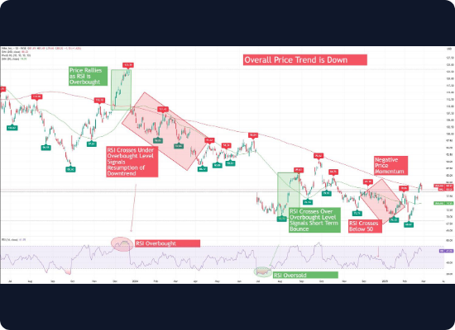
Predicting the Unpredictable
The Holy Grail of Finance
Forecasting stock prices has long been considered one of the most challenging tasks in financial analysis due to the market's inherent volatility and complexity.
From Random Walks to Patterns
While the Efficient Market Hypothesis suggests prices reflect all information instantly, making prediction impossible (Random Walk), Machine Learning aims to identify non-linear patterns that traditional statistical methods might miss.

Slide 3









Core Challenges in Forecasting
Volatility & Noise
Non-Stationarity
Black Swan Events
Financial data is notoriously noisy. Distinguishing between genuine market trends and random daily fluctuations is the primary hurdle for any algorithm.
Statistical properties of stock data (mean, variance) change over time. A model trained on 2020's bull market may fail entirely in a bear market.
Unpredictable external events (geopolitics, pandemics) can cause massive shocks that no historical data-driven model can anticipate.

Slide 4




Traditional Method: ARIMA
AutoRegressive (AR)
Integrated (I)
Uses the dependent relationship between an observation and some number of lagged observations. Essentially, it assumes past values influence future ones.
Involves differencing the raw observations (e.g., subtracting the previous day's price) to make the time series stationary and remove trends.
Moving Average (MA)
Best for: Short-term forecasting on linear, stationary data.
Uses the dependency between an observation and a residual error from a moving average model applied to lagged observations.

Slide 5

The Machine Learning Shift
➢
Handling Non-Linearity: Unlike ARIMA, ML models (like Random Forest and Neural Networks) can capture complex, non-linear relationships in data.
➢
High-Dimensionality: ML can ingest hundreds of features—price, volume, sentiment, economic indicators—simultaneously.
➢
Adaptability: Deep learning models can technically "learn" new patterns as they are fed more data, though overfitting remains a risk.
➢
Classification vs. Regression: ML allows us to predict the exact price (Regression) or simply the direction of movement (Classification).

Slide 6



Feature Engineering: Technical Indicators
Moving Averages
RSI
MACD
SMA & EMA: Smooth out price data to identify the direction of the trend. EMA places more weight on recent data points.
Relative Strength Index: A momentum oscillator that measures the speed and change of price movements to identify overbought or oversold conditions.
Moving Average Convergence Divergence: A trend-following momentum indicator that shows the relationship between two moving averages of a price.

Slide 7
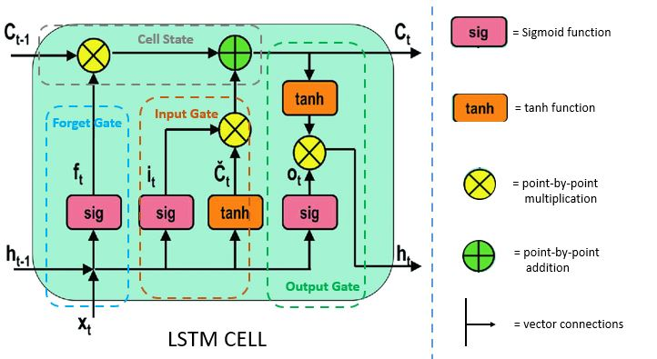
Deep Learning: LSTM
Long Short-Term Memory
Standard RNNs suffer from the "vanishing gradient" problem, making them forget early data in long sequences. LSTMs solve this.
They are designed specifically to learn long-term dependencies, making them perfect for time-series data where context from 50 days ago might influence today's price.
Key Advantage: The ability to selectively remember or forget information.

Slide 8
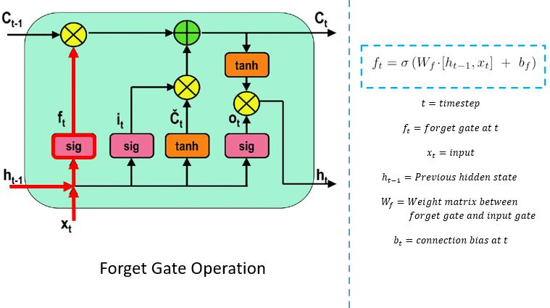

Inside the LSTM Cell
Forget Gate
Decides what information from the previous cell state should be thrown away or kept. It looks at the previous hidden state and current input.

Slide 9
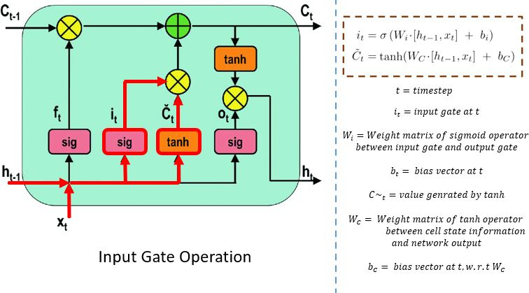

Input Gate
Decides which new information is stored in the cell state. It updates the state with relevant new data from the current time step.

Slide 10
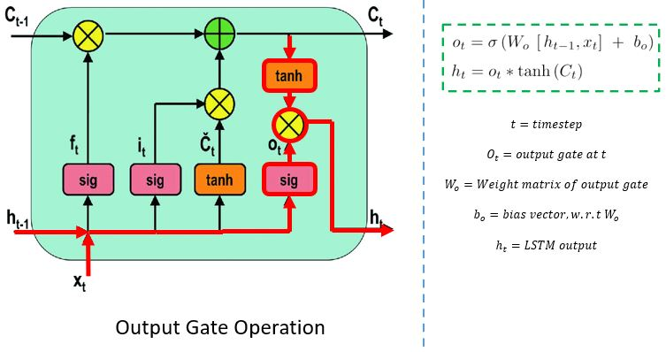

Output Gate
Decides what the next hidden state should be. This hidden state contains information on previous inputs and is used for predictions.

Slide 11
Data Pipeline Strategy
Cleaning
Normalization
Handling missing values, removing outliers, and smoothing noise.
Scaling data (MinMax 0-1) to ensure faster model convergence.
Ingestion
Windowing
Fetching OHLCV data via APIs (Yahoo Finance, Alpha Vantage).
Creating sequences (e.g., using past 60 days to predict day 61).

Slide 12









Evaluation Metrics
RMSE
MAE
MAPE
Root Mean Squared Error
Mean Absolute Error
Mean Absolute Percentage Error
Penalizes larger errors more heavily.
Average magnitude of the errors.
Error represented as a percentage.

Slide 13

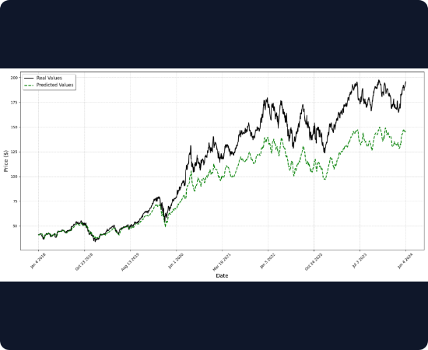
Visualization: Predicted vs. Actual
Interpreting the Chart
The blue line represents the actual historical stock price, while the orange/red line shows the model's predictions.
•
Lag Effect: Notice if the prediction line merely "shadows" the actual price by one day. This indicates the model is just memorizing the previous value.
•
Trend Capture: A good model captures the general upward or downward momentum, even if the exact price point is slightly off.

Slide 14


Future Horizons: Beyond LSTM
Transformers & Attention
Sentiment Analysis
Models like TimeGPT and temporal transformers use "Attention Mechanisms" to weigh the importance of different time steps more effectively than LSTMs, enabling parallel processing and capturing even longer dependencies.
Hybrid models are now integrating Natural Language Processing (NLP) to analyze news headlines, tweets, and earnings call transcripts. This adds a layer of "market sentiment" to the raw price data.

Slide 15







Summary & Future Scope
Future Directions
Conclusion
High Frequency Trading (HFT)
Stock prediction is hard due to noise and non-stationarity.
Implementing FPGA-based inference for microsecond latency.
Feature engineering and data cleaning are more critical than model choice.
LSTMs and Transformers are currently SOTA for time series.
Always validate with Walk-Forward backtesting.
Graph Neural Networks
Modeling relationships between companies (e.g., Apple's supply chain) to predict shock propagation.

Slide 16
THANK YOU

